Slide 1

Programming Your GPU with OpenMP*
Tim Mattson
Intel Corp.
timothy.g.mattson@ intel.com
Simon McIntosh-Smith
University of Bristol
simonm@cs.bris.ac.uk
… and the McIntosh-Smith group at the University of Bristol: Tom Deakin, Matt Martineau and James Price
* The name “OpenMP” is the property of the OpenMP Architecture Review Board.

Slide 2
Disclaimer & Optimization Notice
INFORMATION IN THIS DOCUMENT IS PROVIDED “AS IS”. NO LICENSE, EXPRESS OR IMPLIED, BY ESTOPPEL OR OTHERWISE, TO ANY INTELLECTUAL PROPERTY RIGHTS IS GRANTED BY THIS DOCUMENT. INTEL ASSUMES NO LIABILITY WHATSOEVER AND INTEL DISCLAIMS ANY EXPRESS OR IMPLIED WARRANTY, RELATING TO THIS INFORMATION INCLUDING LIABILITY OR WARRANTIES RELATING TO FITNESS FOR A PARTICULAR PURPOSE, MERCHANTABILITY, OR INFRINGEMENT OF ANY PATENT, COPYRIGHT OR OTHER INTELLECTUAL PROPERTY RIGHT.
Performance tests and ratings are measured using specific computer systems and/or components and reflect the approximate performance of Intel products as measured by those tests. Any difference in system hardware or software design or configuration may affect actual performance. Buyers should consult other sources of information to evaluate the performance of systems or components they are considering purchasing. For more information on performance tests and on the performance of Intel products, reference www.intel.com/software/products.
All rights reserved. Intel, the Intel logo, Xeon, Xeon Phi, VTune, and Cilk are trademarks of Intel Corporation in the U.S. and other countries. *Other names and brands may be claimed as the property of others.
Optimization Notice
Intel’s compilers may or may not optimize to the same degree for non-Intel microprocessors for optimizations that are not unique to Intel microprocessors. These optimizations include SSE2, SSE3, and SSSE3 instruction sets and other optimizations. Intel does not guarantee the availability, functionality, or effectiveness of any optimization on microprocessors not manufactured by Intel. Microprocessor-dependent optimizations in this product are intended for use with Intel microprocessors. Certain optimizations not specific to Intel microarchitecture are reserved for Intel microprocessors. Please refer to the applicable product User and Reference Guides for more information regarding the specific instruction sets covered by this notice. Notice revision #20110804

Slide 3
Preliminaries: Part 1
Disclosures
The views expressed in this tutorial are those of the people delivering the tutorial.
We are not speaking for our employers.
We are not speaking for the OpenMP ARB
We take these tutorials VERY seriously:
Help us improve … tell us how you would make this tutorial better.

Slide 4
Preliminaries: Part 2
Our plan for the day .. Active learning!
We will mix short lectures with short exercises.
You will use your laptop to connect to a multiprocessor server.
Please follow these simple rules
Do the exercises that we assign and then change things around and experiment.
Embrace active learning!
Don’t cheat: Do Not look at the solutions before you complete an exercise … even if you get really frustrated.

Slide 5

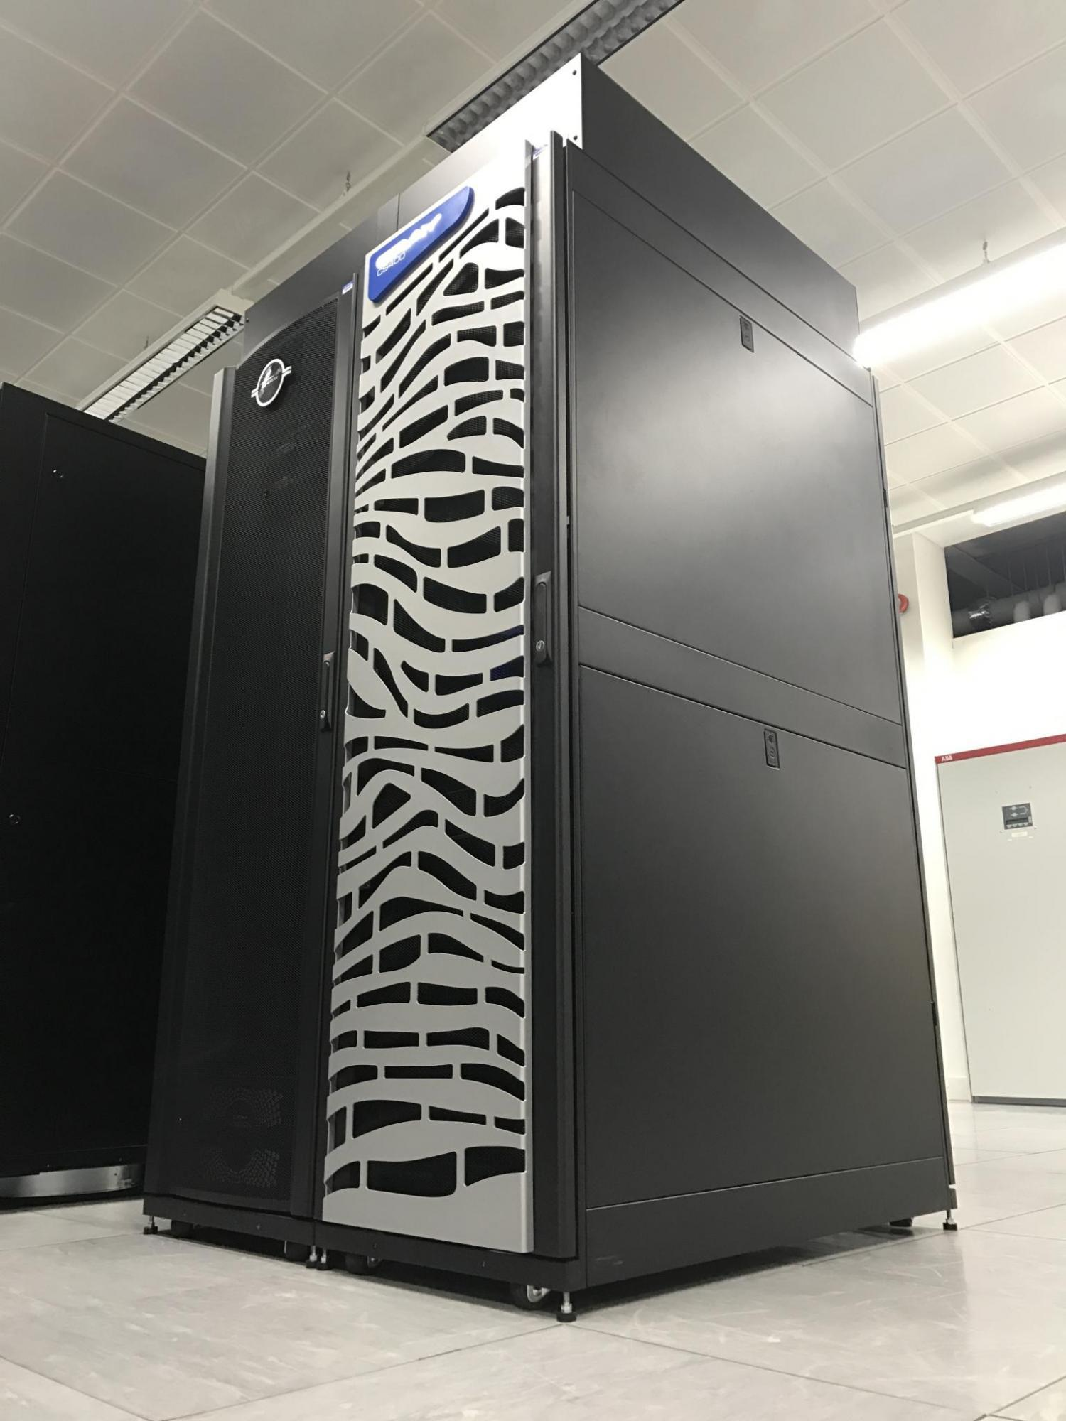




Collaboration between GW4 Alliance (universities of Bristol, Bath, Cardiff, Exeter), the UK Met Office, Cray, and Arm
~£3 million, funded by EPSRC
Expected to be the first large-scale, Arm-based production supercomputer
10,000+ Armv8 cores
Also contains some Intel Xeon Phi (KNL), Intel Xeon (Broadwell), and NVIDIA P100 GPUs
Cray compilers provide the OpenMP implementation for GPU offloading

Slide 6
Plan
Module | Concepts | Exercises
OpenMP overview | OpenMP recap Hardcore jargon of OpenMP | None … we’ll use demo mode so we can move fast
The device model in OpenMP | Intro to the Target directive with default data movement | Vadd program
Understanding execution | Intro to nvprof | nvprof ./vadd
Working with the target directive | CPU and GPU execution models and the fundamental combined directive | Vadd with combined directive using nvprof to understand execution
Basic memory movement | The map clause | Jacobi solver
Optimizing memory movement | Target data regions | Jacobi with explicit data movement
Optimizing GPU code | Common GPU optimizations | Optimized Jacobi solver

Slide 7
Agenda
OpenMP overview
The device model in OpenMP
Understanding execution on the GPU with nvprof
Working with the target directive
Controlling memory movement
Optimizing GPU code
CPU/GPU portability

Slide 8
OpenMP* overview:
C$OMP FLUSH
#pragma omp critical
C$OMP THREADPRIVATE(/ABC/)
CALL OMP_SET_NUM_THREADS(10)
OpenMP: An API for Writing Multithreaded Applications
A set of compiler directives and library routines for parallel application programmers
Greatly simplifies writing multi-threaded (MT) programs in Fortran, C and C++
Standardizes established SMP practice + vectorization and heterogeneous device programming
C$OMP parallel do shared(a, b, c)
call omp_test_lock(jlok)
call OMP_INIT_LOCK (ilok)
C$OMP MASTER
C$OMP ATOMIC
C$OMP SINGLE PRIVATE(X)
setenv OMP_SCHEDULE “dynamic”
C$OMP PARALLEL DO ORDERED PRIVATE (A, B, C)
C$OMP ORDERED
C$OMP PARALLEL REDUCTION (+: A, B)
C$OMP SECTIONS
#pragma omp parallel for private(A, B)
!$OMP BARRIER
C$OMP PARALLEL COPYIN(/blk/)
C$OMP DO lastprivate(XX)
Nthrds = OMP_GET_NUM_PROCS()
omp_set_lock(lck)
* The name “OpenMP” is the property of the OpenMP Architecture Review Board.

Slide 9
OpenMP programming model:
Fork-Join Parallelism:
Master thread spawns a team of threads as needed.
Parallelism added incrementally until performance goals are met, i.e., the sequential program evolves into a parallel program.
Parallel Regions
A Nested Parallel region
Master Thread in red
Sequential Parts

Slide 10
Numerical integration: the pi program
Mathematically, we know that:
1
4.0
∫
4.0
dx = π
(1+x²)
0
We can approximate the integral as a sum of rectangles:
2.0
F(x) = 4.0/(1+x²)
N
∑ F(x_{i})Δx ≈ π
i = 0
Where each rectangle has width Δx and height F(x_{i}) at the middle of interval i.
0.0
X
1.0

Slide 11
Serial PI program
static long num_steps = 100000;
double step;
int main ()
{ int i; double x, pi, sum = 0.0;
step = 1.0/(double) num_steps;
for (i=0; i< num_steps; i++){
x = (i+0.5)*step;
sum = sum + 4.0/(1.0+x*x);
}
pi = step * sum;
}
See sc17-tutorial/pi.c

Slide 12
Example: Pi with a loop and a reduction
#include <omp.h>
static long num_steps = 100000; double step;
void main ()
{ int i; double x, pi, sum = 0.0;
step = 1.0/(double) num_steps;
#pragma omp parallel
{
double x;
#pragma omp for reduction(+:sum)
for (i=0; i< num_steps; i++){
x = (i+0.5)*step;
sum = sum + 4.0/(1.0+x*x);
}
}
pi = step * sum;
}
Create a team of threads … without a parallel construct, you’ll never have more than one thread
Create a scalar local to each thread to hold value of x at the center of each interval
Break up loop iterations and assign them to threads … setting up a reduction into sum. Note … the loop index is local to a thread by default.

Slide 13
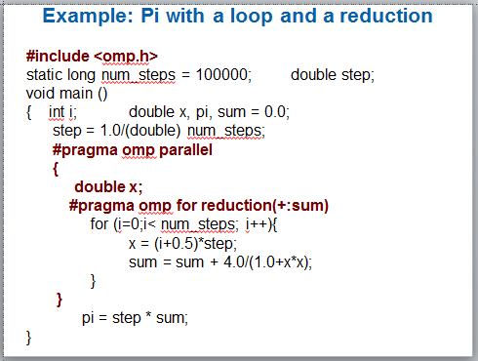
Results*: pi with a loop and a reduction
Original Serial pi program with 100000000 steps ran in 1.83 seconds.
threads | PI Loop (s)
1 | 1.91
2 | 1.02
3 | 0.80
4 | 0.68
*Intel compiler (icpc) with no optimization on Apple OS X 10.7.3 with a dual core (four HW thread) Intel® CoreTM i5 processor at 1.7 Ghz and 4 Gbyte DDR3 memory at 1.333 Ghz.

Slide 14
The growth of complexity in OpenMP
OpenMP started out in 1997 as a simple interface for the application programmers more versed in their area of science than computer science.
The complexity has grown considerably over the years!
Page counts (not counting front matter, appendices or index) for versions of OpenMP
4.5
Fortran spec
C/C++ spec
4.0
Merged C/C++ and Fortran spec
Page counts (spec only)
3.1
3.0
year
The complexity of the full spec is overwhelming, so we focus on the 16 constructs most OpenMP programmers restrict themselves to … the so called “OpenMP Common Core”

Slide 15
The growth of complexity in OpenMP
OpenMP started out in 1997 as a simple interface for the application programmers more versed in their area of science than computer science.
The complexity has grown considerably over the years!
Page counts (not counting front matter, appendices or index) for versions of OpenMP
4.5
Fortran spec
C/C++ spec
4.0
Merged C/C++ and Fortran spec
Page counts (spec only)
3.1
3.0
Tasks added to OpenMP ... supports irregular parallelism
year
The complexity of the full spec is overwhelming, so we focus on the 19 constructs most OpenMP programmers restrict themselves to … the so called “OpenMP Common Core”

Slide 16
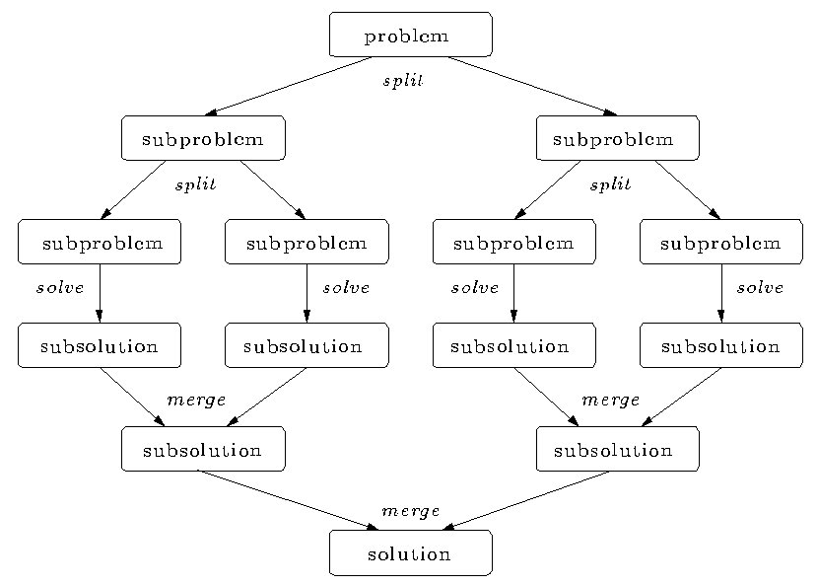
Divide and conquer
Split the problem into smaller sub-problems; continue until the sub-problems can be solved directly
3 Options:
Do work as you split into sub-problems
Do work only at the leaves
Do work as you recombine

Slide 17
Program: OpenMP tasks
#include <omp.h>
static long num_steps = 100000000;
#define MIN_BLK 10000000
double pi_comp(int Nstart,int Nfinish,double step)
{ int i,iblk;
double x, sum = 0.0,sum1, sum2;
if (Nfinish-Nstart < MIN_BLK){
for (i=Nstart;i< Nfinish; i++){
x = (i+0.5)*step;
sum = sum + 4.0/(1.0+x*x); } }
else{
iblk = Nfinish-Nstart;
#pragma omp task shared(sum1)
sum1 = pi_comp(Nstart, Nfinish-iblk/2,step);
#pragma omp task shared(sum2)
sum2 = pi_comp(Nfinish-iblk/2, Nfinish, step);
#pragma omp taskwait
sum = sum1 + sum2;
}return sum;
}
int main ()
{
int i;
double step, pi, sum;
step = 1.0/(double) num_steps;
#pragma omp parallel
{
#pragma omp single
sum = pi_comp(0,num_steps,step);
}
pi = step * sum;
}

Slide 18
Adding tasks to OpenMP required major changes to the specification
Fork-Join Parallelism:
Master thread spawns a team of threads as needed.
Parallelism added incrementally until performance goals are met, i.e., the sequential program evolves into a parallel program.
Parallel Regions
Master Thread in red
Sequential Parts

Slide 19
Adding tasks to OpenMP required major changes to the specification
Fork-Join Parallelism:
Master thread spawns a team of threads as needed.
Parallelism added incrementally until performance goals are met, i.e., the sequential program evolves into a parallel program.
Master Thread in red
Let’s focus on just one fork/join

Slide 20
Low Level details of OpenMP
Program begins. Launches Initial thread.
Threads wait at barrier
Implicit parallel region surrounds entire program
Barrier satisfied
Implicit tasks terminate
Initial task begins execution
Initial thread encounters the parallel construct.
Initial task continues
Initial task creates a team of threads
Each thread in the team runs the implicit task defined by the parallel region
Initial task is suspended

Slide 21
Why all this complexity around tasks?
Remember: a language specification is written for people who implement the language … they have ZERO tolerance for ANY ambiguity.
By defining a thread as an execution entity that runs tasks, we can define semantics in terms of tasks and consistently apply it everywhere.
While all these initial threads, implicit tasks, and such are confusing to the programmer, they actually make life easier for people who implement OpenMP.

Slide 22
The OpenMP Common Core: Most OpenMP programs only use these 19 items
OpenMP pragma, function, or clause | Concepts
#pragma omp parallel | Parallel region, teams of threads, structured block, interleaved execution across threads
int omp_get_thread_num() int omp_get_num_threads() | Create threads with a parallel region and split up the work using the number of threads and thread ID
double omp_get_wtime() | Speedup and Amdahl's law. False Sharing and other performance issues
setenv OMP_NUM_THREADS N | Internal control variables. Setting the default number of threads with an environment variable
#pragma omp barrier #pragma omp critical | Synchronization and race conditions. Revisit interleaved execution.
#pragma omp for #pragma omp parallel for | Worksharing, parallel loops, loop carried dependencies
reduction(op:list) | Reductions of values across a team of threads
schedule(dynamic [,chunk]) schedule (static [,chunk]) | Loop schedules, loop overheads and load balance
private(list), firstprivate(list), shared(list) | Data environment
nowait | Disabling implied barriers on workshare constructs, the high cost of barriers. The flush concept (but not the concept)
#pragma omp single | Workshare with a single thread
#pragma omp task #pragma omp taskwait | Tasks including the data environment for tasks.

Slide 23
The growth of complexity in OpenMP
OpenMP started out in 1997 as a simple interface for the application programmers more versed in their area of science than computer science.
The complexity has grown considerably over the years!
Page counts (not counting front matter, appendices or index) for versions of OpenMP
Target constructs added to OpenMP ... supports host-device model
4.5
Fortran spec
C/C++ spec
4.0
Merged C/C++ and Fortran spec
Page counts (spec only)
3.1
3.0
Tasks added to OpenMP ... supports irregular parallelism
year
The complexity of the full spec is overwhelming, so we focus on the 19 constructs most OpenMP programmers restrict themselves to … the so called “OpenMP Common Core”

Slide 24
Agenda
OpenMP overview
The device model in OpenMP
Understanding execution on the GPU with nvprof
Working with the target directive
Controlling memory movement
Optimizing GPU code
CPU/GPU portability

Slide 25
The OpenMP device programming model
OpenMP uses a host/device model
The host is where the initial thread of the program begins execution
Zero or more devices are connected to the host
…
…
#include <omp.h>
#include <stdio.h>
int main()
{
printf(“There are %d devices\n”,
omp_get_num_devices());
}
…
…
…
…
…
…
…
Host
…
…
…
…
…
…
Device

Slide 26
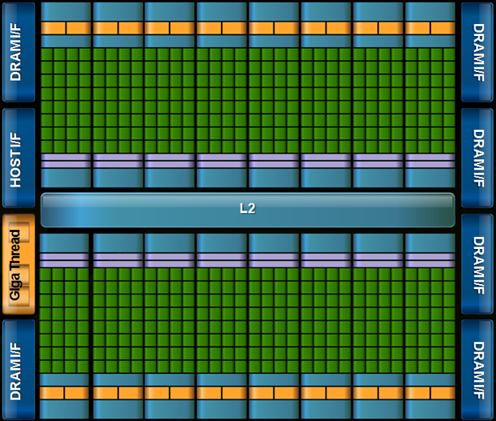
OpenMP with target devices
The target construct offloads execution to a device.
#pragma omp target
{….} // a structured block of code
Program begins. Launches Initial thread running on the host device.
Initial task on host continues once execution associated with the target region completes
Implicit parallel region surrounds entire program
Initial task begins execution
Initial thread encounters the target directive.
Initial task generates a target task which is a mergable, included task
A new initial thread runs on the device.
Target task launches target region on the device
Implicit parallel region surrounds device program
Initial task executes code in the target region.

Slide 27
The target data environment
Scalars and statically allocated arrays are moved onto the device by default before execution
Host thread
Generating Task
float A[N], B[N];
A, B and N mapped to the device
#pragma omp target
Initial task
Host thread
waits for the task region to complete
{
target region, can use A, B and N
}
Target task
Device Initial thread
the arrays A and B mapped back to the host
Only the statically allocated arrays are moved back to the host after the target region completes
Based on figure 6.4 in Using OpenMP – The Next Step by van der Pas, Stotzer and Terboven, MIT Press, 2017

Slide 28
Exercise
Use the provided serial vadd program which adds two vectors and tests the results.
Use the target construct to run the code on a GPU.
Experiment with the other OpenMP constructs if time.
#pragma omp target
#pragma omp parallel
#pragma omp for
#pragma omp for reduction(op:list)
#pragma omp for private(list)
#pragma omp target

Slide 29
Using Isambard (1/2)
# Log in to the Isambard bastion node
# This node acts as a gateway to the rest of the system
# You will be assigned an account ID (01, 02, …)
# Your password is openmpSC17
ssh br-trainXX@isambard.gw4.ac.uk
# Log in to Isambard Phase 1
ssh phase1
# Change to directory containing exercises
cd sc17-tutorial
# List files
ls
Job submission scripts
[br-train01@login-01 sc17-tutorial]$ ls
jac_solv.c makefile mm_utils.h submit_jac_solv vadd.c
make.def makefile pi.c submit_pi
Make_def_files mm_utils.c Solutions submit_vadd
Jacobi exercise starting code
Pi exercise starting code
vadd exercise starting code

Slide 30
Using Isambard (2/2)
# Build exercises
make
# Submit job
qsub submit_vadd
# Check job status
qstat -u $USER
# Check output from job
# Output file will have the job identifier in name
# This will be different each time you run a job
cat vadd.oXXXX
Job status:
Q = Queued
R = Running
C = Complete
(job will disappear shortly after completion)
Req'd Req'd Elap
Job ID Username Queue Jobname SessID NDS TSK Memory Time S Time
--------------- -------- -------- ---------- ------ --- --- ------ ----- - -----
9376.master.gw4 br-trai pascalq vadd 154770 1 36 -- 00:02 R 00:00

Slide 31
OpenMP target directive: the nowait clause
Make the target task (running on the host) execute as a deferred task
#pragma omp target nowait
{
// code defines a target region
}
#pragma omp parallel for
for(int i=0;i<N;i++) {
big_stuff(i);
}
#pragma omp taskwait
The thread’s implicit task can define other (potentially parallel) work.
The implicit task running on the host waits for the target region to complete.

Slide 32
Commonly used clauses with target
#pragma omp target [clause[[,]clause]...]
structured-block
if(scalar-expression)
If the scalar-expression evaluates to false then the target region is executed by the host device in the host data environment.
device(integer-expression)
The value of the integer-expression selects the device when a device other than the default device is desired
private(list) firstprivate(list)
creates variables with the same name as those in the list on the device. In the case of firstprivate, the value of the original variable on the host is copied into the private variable created on the device.
map(map-type: list)
map-type may be to, from, tofrom, or alloc. The clause defines how the variables in list are moved between the host and the device.
nowait
The target task is deferred which means the host can run code in parallel to the target region.

Slide 33
Agenda
OpenMP overview
The device model in OpenMP
Understanding execution on the GPU with nvprof
Working with the target directive
Controlling memory movement
Optimizing GPU code
CPU/GPU portability

Slide 34
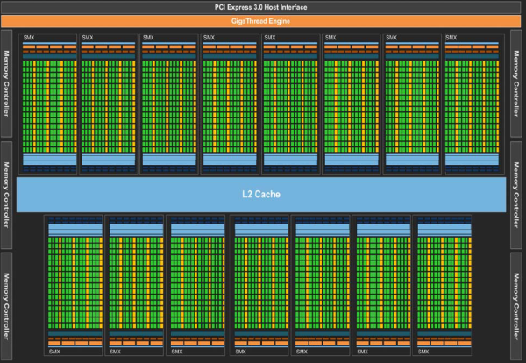
How do we execute code on a GPU: The SIMT model (Single Instruction Multiple Thread)
Turn source code into a scalar work-item
Map work-items onto an an N dim index space.
Run on hardware designed around the same SIMT execution model
extern void reduce( __local float*, __global float*);
__kernel void pi( const int niters, float step_size, __local float* l_sums, __global float* p_sums)
{
int n_wrk_items = get_local_size(0);
int loc_id = get_local_id(0);
int grp_id = get_group_id(0);
float x, accum = 0.0f; int i,istart,iend;
istart = (grp_id * n_wrk_items + loc_id) * niters;
iend = istart+niters;
for(i= istart; i<iend; i++){
x = (i+0.5f)*step_size; accum += 4.0f/(1.0f+x*x); }
l_sums[local_id] = accum;
barrier(CLK_LOCAL_MEM_FENCE);
reduce(l_sums, p_sums);
}
Map data structures onto the same index space
This is OpenCL kernel code … the sort of code the OpenMP compiler generates on your behalf
Third Party names are the property of their owners

Slide 35
How do we execute code on a GPU: OpenCL and CUDA nomenclature
Organize work-items into work-groups and map onto an an N dim index space. Cuda calls a work-group a thread-block
Turn source code into a scalar work-item (a CUDA thread)
Submit a kernel to an OpenCL command queue or a CUDA stream
extern void reduce( __local float*, __global float*);
__kernel void pi( const int niters, float step_size, __local float* l_sums, __global float* p_sums)
{
int n_wrk_items = get_local_size(0);
int loc_id = get_local_id(0);
int grp_id = get_group_id(0);
float x, accum = 0.0f; int i,istart,iend;
istart = (grp_id * n_wrk_items + loc_id) * niters;
iend = istart+niters;
for(i= istart; i<iend; i++){
x = (i+0.5f)*step_size; accum += 4.0f/(1.0f+x*x); }
l_sums[local_id] = accum;
barrier(CLK_LOCAL_MEM_FENCE);
reduce(l_sums, p_sums);
}
OpenCL index space is called an NDRange. CUDA calls this a Grid
This code defines a kernel
It’s called SIMT, but GPUs are really vector-architectures with a block of work-items called a warp executing together
Third Party names are the property of their owners

Slide 36

CUDA Toolkit
The CUDA toolkit works with code written in OpenMP 4.5 without any changes
We will demonstrate using an OpenMP 4.5 version of flow
Hydrodynamics mini-app solving Euler’s compressible equations
Explicit 2D method that uses various stencils, keeping data resident on GPU for entire solve

Slide 37
CUDA Toolkit: NVProf
Simple profiling: nvprof ./exe <params>
Time to copy data onto GPU
Time to copy data back from GPU
Profiling data
Timings for computational kernels

Slide 38
CUDA Toolkit: NVProf
Trace profiling: nvprof --print-gpu-trace ./exe <params>
Shows block sizes, grid dimensions and register counts for kernels
Entries ordered by time

Slide 39
Other CUDA Toolkit tools
nvidia-smi – displays some information about NVIDIA devices on a node
cudagdb – command line debugger in the style of GDB that allows kernel debugging
cuda-memcheck – tool to catch memory access errors in a CUDA application
nvvp – visual optimisation application that can use profiling data from nvprof

Slide 40
Exercise
Use the vadd program from the previous exercise and explore how it executes on a GPU using nvprof.
nvprof ./vadd
nvprof --print-gpu-trace ./vadd
Change the problem size and get a feel for how the grid and block-size change.
You will need to edit the job submission files to submit the job to the queue with nvprof. For example:
Replace the line
./vadd
with the line (for example)
nvprof --print-gpu-trace ./vadd

Slide 41
Agenda
OpenMP overview
The device model in OpenMP
Understanding execution on the GPU with nvprof
Working with the target directive
Controlling memory movement
Optimizing GPU code
CPU/GPU portability

Slide 42
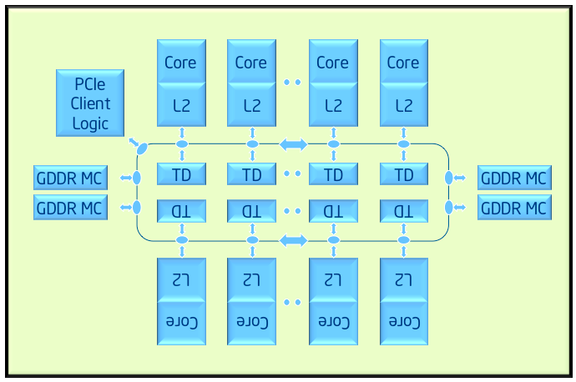
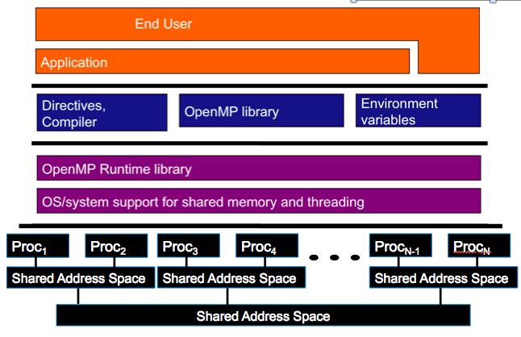
OpenMP device model: Examples
A couple key devices we considered when designing the device model in OpenMP
Target Device: Intel® Xeon Phi™ processor
Host
Target Device: GPU

Slide 43
A Generic Host/Device Platform Model
…
…
…
…
…
…
…
Processing Element
…
…
Host
…
…
…
…
…
…
Compute Unit
Device
One Host and one or more Devices
Each Device is composed of one or more Compute Units
Each Compute Unit is divided into one or more Processing Elements
Memory divided into host memory and device memory
Third party names are the property of their owners.

Slide 44
Our host/device Platform Model and OpenMP
…
…
…
…
…
…
…
Processing Element
…
…
Host
…
…
…
…
…
…
Target construct to get onto a device
Compute Unit
Device
Parallel for simd to run each block of loop iterations on the processing elements
Teams construct to create a league of teams with one team of threads on each compute unit.
Distribute clause to assign blocks of loop iterations to teams.

Slide 45
Our host/device Platform Model and OpenMP
Typical usage ... let the compiler do what’s best for the device:
…
…
…
#pragma omp target
to get on the device
…
…
…
…
Processing Element
…
…
Host
…
…
…
…
…
…
Target construct to get onto a device
Compute Unit
Device
Parallel for simd to run each block of loop iterations on the processing elements
Teams construct to create a league of teams with one team of threads on each compute unit.
Distribute clause to assign blocks of loop iterations to teams.
#pragma omp teams distribute parallel for simd
to assign work to the device processing elements

Slide 46
Consider the familiar VADD example
#include<omp.h>
#include<stdio.h>
#define N 1024
int main()
{
float a[N], b[N], c[N];
int i;
// initialize a, b and c ….
for(i=0;i<N;i++)
c[i] += a[i] + b[i];
// Test results, report results …
}

Slide 47
Consider the familiar VADD example
#include<omp.h>
#include<stdio.h>
#define N 1024
int main()
{
float a[N], b[N], c[N];
int i;
// initialize a, b and c ….
#pragma omp target
#pragma omp teams distribute parallel for simd
for(i=0;i<N;i++)
c[i] += a[i] + b[i];
// Test results, report results …
}
original variables i, a, b, c are copied to the device at beginning of construct
original variables a, b, c are copied to the host at the end of construct

Slide 48
Commonly used clauses on teams distribute parallel for simd
The basic construct is:
#pragma omp teams distribute parallel for simd [clause[[,]clause]...]
for-loops
The most commonly used clauses are:
private(list) firstprivate(list) lastprivate(list) shared(list)
behave as data environment clauses in the rest of OpenMP, but note values are only created or copied into the region, not back out “at the end”.
reduction(reduction-identifier : list)
behaves as in the rest of OpenMP … but the variable must appear in a map(tofrom) clause on the associated target construct in order to get the value back out at the end
collapse(n)
Combines loops before the distribute directive splits up the iterations between teams
dist_schedule(kind[, chunk_size])
only supports kind= static. Otherwise works the same as when applied to a for construct. Note: this applies to the operation of the distribute directive and controls distribution of loop iterations onto teams (NOT the distribution of loop iterations inside a team).

Slide 49
Controlling data movement
Data movement can be explicitly controlled with the map clause
int i, a[N], b[N], c[N];
#pragma omp target map(to:a,b) map(tofrom:c)
The various forms of the map clause
map(to:list): read-only data on the device. Variables in the list are initialized on the device using the original values from the host.
map(from:list): write-only data on the device: initial value of the variable is not initialized. At the end of the target region, the values from variables in the list are copied into the original variables.
map(tofrom:list): the effect of both a map-to and a map-from
map(alloc:list): data is allocated and uninitialized on the device.
map(list): equivalent to map(tofrom:list).
For pointers you must use array notation ..
map(to:a[0:N])

Slide 50
Default Data Mapping: Scalar variables (i.e. mapping scalars between host and target regions)
Default mapping behavior for scalar variables
OpenMP 4.0 implicitly mapped all scalar variables as tofrom
OpenMP 4.5 implicitly maps scalar variables as firstprivate
Key difference between the two options:
firstprivate:
a new value is created per work-item and initialized with the original value. The variable is not copied back to the host
map(tofrom):
A new value is created in the target region and initialized with the original value, but it is shared between work-items on the device. Its value is copied back to the host at the end of the target region.
Why is default firstprivate for scalars a better choice?
OpenMP target regions for GPUs execute with CUDA or OpenCL. A firstprivate scalar can be launched as a parameter to a kernel function without the overhead of setting up a variable in device memory.

Slide 51
Default Data Sharing
WARNING: Make sure not to confuse the implicit mapping of pointer variables with the data that they point to
int main(void) {
int A = 0;
int* B = malloc(sizeof(int)*N);
#pragma omp target
#pragma omp teams distribute parallel for simd
for(int ii = 0; ii < N; ++ii) {
// A, B, N and ii all exist here
// B is a pointer variable! The data that B points to DOES NOT exist here!
} }
If you want to access the data that is pointed to by B, you will need to perform an explicit mapping using the map clause

Slide 52
Default Data Sharing
WARNING: Make sure not to confuse the implicit mapping of pointer variables with the data that they point to
int main(void) {
int A = 0;
int* B = malloc(sizeof(int)*N);
#pragma omp target map(B[0:N])
#pragma omp teams distribute parallel for simd
for(int ii = 0; ii < N; ++ii) {
// A, B, N and ii all exist here
// The data that B points to DOES exist here!
} }

Slide 53
Exercise: Jacobi solver
Start from the provided jacobi_solver program. Verify that you can run it serially.
Parallelize for a CPU using the parallel for construct on the major loops
Use the target directive to run on a GPU.
#pragma omp target
#pragma omp target map(to:list) map(from:list) map(tofrom:list)
#pragma omp target teams distribute parallel for simd

Slide 54
Jacobi Solver (serial 1/2)
<<< allocate and initialize the matrix A and >>>
<<< vectors x1, x2 and b >>>
while((conv > TOL) && (iters<MAX_ITERS))
{
iters++;
xnew = iters % s ? x2 : x1;
xold = iters % s ? x1 : x2;
for (i=0; i<Ndim; i++){
xnew[i] = (TYPE) 0.0;
for (j=0; j<Ndim;j++){
if(i!=j)
xnew[i]+= A[i*Ndim + j]*xold[j];
}
xnew[i] = (b[i]-xnew[i])/A[i*Ndim+i];
}

Slide 55
Jacobi Solver (serial 2/2)
//
// test convergence
//
conv = 0.0;
for (i=0; i<Ndim; i++){
tmp = xnew[i]-xold[i];
conv += tmp*tmp;
}
conv = sqrt((double)conv);
} // end while loop

Slide 56
Jacobi Solver (Par Targ, 1/2)
while((conv > TOL) && (iters<MAX_ITERS))
{
iters++;
xnew = iters % 2 ? x2 : x1;
xold = iters % 2 ? x1 : x2;
#pragma omp target map(tofrom:xnew[0:Ndim],xold[0:Ndim]) \
map(to:A[0:Ndim*Ndim], b[0:Ndim] ,Ndim)
#pragma omp teams distribute parallel for simd private(i,j)
for (i=0; i<Ndim; i++){
xnew[i] = (TYPE) 0.0;
for (j=0; j<Ndim;j++){
if(i!=j)
xnew[i]+= A[i*Ndim + j]*xold[j];
}
xnew[i] = (b[i]-xnew[i])/A[i*Ndim+i];
}

Slide 57
Jacobi Solver (Par Targ, 2/2)
//
// test convergence
//
conv = 0.0;
#pragma omp target map(to:xnew[0:Ndim],xold[0:Ndim]) \
map(to:Ndim) map(tofrom:conv)
#pragma omp teams distribute parallel for simd \
private(i,tmp) reduction(+:conv)
for (i=0; i<Ndim; i++){
tmp = xnew[i]-xold[i];
conv += tmp*tmp;
}
conv = sqrt((double)conv);
} \\ end while loop

Slide 58
Jacobi Solver (Par Targ, 2/2)
//
// test convergence
//
conv = 0.0;
#pragma omp target map(to:xnew[0:Ndim],xold[0:Ndim]) \
map(to:Ndim) map(tofrom:conv)
#pragma omp teams distribute parallel for simd \
private(i,tmp) reduction(+:conv)
for (i=0; i<Ndim; i++){
tmp = xnew[i]-xold[i];
conv += tmp*tmp;
}
conv = sqrt((double)conv);
} \\ end while loop
This worked but the performance was awful. Why?
System | Implementation | Ndim = 4096
NVIDA® K20X™ GPU | Target dir per loop | 131.94 secs
Cray® XC40™ Supercomputer running Cray® Compiling Environment 8.5.3. Intel® Xeon ® CPU E5-2697 v2 @ 2.70GHz with 32 GB DDR3. NVIDIA® Tesla® K20X, 6GB.
Third party names are the property of their owners.

Slide 59
Agenda
OpenMP overview
The device model in OpenMP
Working with the target directive
Controlling memory movement
Optimizing GPU code
CPU/GPU portability

Slide 60
Data movement dominates!!!
while((conv > TOLERANCE) && (iters<MAX_ITERS))
{ iters++;
xnew = iters % s ? x2 : x1;
xold = iters % s ? x1 : x2;
#pragma omp target map(tofrom:xnew[0:Ndim],xold[0:Ndim]) \
map(to:A[0:Ndim*Ndim], b[0:Ndim] ,Ndim)
#pragma omp teams distribute parallel for simd private(i,j)
for (i=0; i<Ndim; i++){
xnew[i] = (TYPE) 0.0;
for (j=0; j<Ndim;j++){
if(i!=j)
xnew[i]+= A[i*Ndim + j]*xold[j];
}
xnew[i] = (b[i]-xnew[i])/A[i*Ndim+i];
}
// test convergence
conv = 0.0;
#pragma omp target map(to:xnew[0:Ndim],xold[0:Ndim]) \
map(to:Ndim) map(tofrom:conv)
#pragma omp teams distribute parallel for private(i,tmp) reduction(+:conv)
for (i=0; i<Ndim; i++){
tmp = xnew[i]-xold[i];
conv += tmp*tmp;
}
conv = sqrt((double)conv);
}
Typically over 4000 iterations!
For each iteration, copy to device (3*Ndim+Ndim²)*sizeof(TYPE) bytes
For each iteration, copy from device 2*Ndim*sizeof(TYPE) bytes
For each iteration, copy to device 2*Ndim*sizeof(TYPE) bytes

Slide 61
Target data directive
The target data construct creates a target data region.
You use the map clauses for explicit data management
#pragma omp target data map(to: A,B) map(from: C)
{….} // a structured block of code
Data copied into the device data environment at the beginning of the directive and at the end
Inside the target data region, multiple target regions can work with the single data region
#pragma omp target data map(to: A,B) map(from: C)
{
#pragma omp target
{do lots of stuff with A, B and C}
{do something on the host}
#pragma omp target
{do lots of stuff with A, B, and C}
}

Slide 62
Target update directive
You can update data between target regions with the target update directive.
#pragma omp target data map(to: A,B) map(from: C)
{
#pragma omp target
{do lots of stuff with A, B and C}
#pragma omp update from(A)
host_do_something_with(A)
#pragma omp update to(A)
#pragma omp target
{do lots of stuff with A, B, and C}
}
Copy A on the device to A on the host.
Copy A on the host to A on the device.

Slide 63
Target update details
#pragma omp target update clause[[[,]clause]...]new-line
creates a target task to handle data movement between the host and a devce
clause is either motion-clause or one of the following:
if(scalar-expression)
device(integer-expression)
nowait
depend (dependence-type : list)
the motion-clause is one of the following:
to(list)
from(list)
This directive generates a target task.
nowait and depend apply to the target task running on the host.

Slide 64
Exercise
Modify your parallel jacobi_solver from the last exercise.
Use the target data construct to create a data region. Manage data movement with map clauses to minimize data movement.
#pragma omp target
#pragma omp target data
#pragma omp target map(to:list) map(from:list) map(tofrom:list)
#pragma omp parallel for reduction(+:var) private(list)

Slide 65
Jacobi Solver (Par Targ Data, 1/2)
#pragma omp target data map(tofrom:x1[0:Ndim],x2[0:Ndim]) \
map(to:A[0:Ndim*Ndim], b[0:Ndim] ,Ndim)
while((conv > TOL) && (iters<MAX_ITERS))
{ iters++;
// alternate x vectors.
xnew = iters % 2 ? x2 : x1;
xold = iters % 2 ? x1 : x2;
#pragma omp target
#pragma omp teams distribute parallel for simd private(j)
for (i=0; i<Ndim; i++){
xnew[i] = (TYPE) 0.0;
for (j=0; j<Ndim;j++){
if(i!=j)
xnew[i]+= A[i*Ndim + j]*xold[j];
}
xnew[i] = (b[i]-xnew[i])/A[i*Ndim+i];
}

Slide 66
Jacobi Solver (Par Targ Data, 2/2)
//
// test convergence
//
conv = 0.0;
#pragma omp target map(tofrom: conv)
{
#pragma omp teams distribute parallel for simd \
private(tmp) reduction(+:conv)
for (i=0; i<Ndim; i++){
tmp = xnew[i]-xold[i];
conv += tmp*tmp;
}
} // end target region
conv = sqrt((double)conv);
} // end while loop
System | Implementation | Ndim = 4096
NVIDA® K20X™ GPU | Target dir per loop | 131.94 secs
 | Above plus target data region | 18.37 secs
Third party names are the property of their owners.

Slide 67
Agenda
OpenMP overview
The device model in OpenMP
Working with the target directive
Controlling memory movement
Optimizing GPU code
CPU/GPU portability

Slide 68
Single Instruction Multiple Data
Individual work-items of a warp start together at the same program address
Each work-item has its own instruction address counter and register state
Each work-item is free to branch and execute independently
Supports the SPMD pattern.
Branch behavior
Each branch will be executed serially
Work-items not following the current branch will be disabled
A warp
Time
Start
Branch1
Branch2
Branch3
Converge

Slide 69
Branching
GPUs tend not to support speculative execution, which means that branch instructions have high latency
This latency can be hidden by switching to alternative work-items/work-groups, but avoiding branches where possible is still a good idea to improve performance
When different work-items executing within the same SIMD ALU array take different paths through conditional control flow, we have divergent branches (vs. uniform branches)
Divergent branches are bad news: some work-items will stall while waiting for the others to complete
We can use predication, selection and masking to convert conditional control flow into straight line code and significantly improve the performance of code that has lots of conditional branches
Notes:
Branches will cause pipeline stalls if there’s no branch prediction/speculative execution

Slide 70
Branching
Conditional execution
Selection and masking
// Only evaluate expression
// if condition is met
if (a > b)
{
acc += (a - b*c);
}
// Always evaluate expression
// and mask result
temp = (a - b*c);
mask = (a > b ? 1.f : 0.f);
acc += (mask * temp);
Notes:
Mask 0 if a <= b
Single-cycle multiply-add means we get the extra multiplication by the mask for free
No branches means there won’t be any pipeline stalls
Subtle point: more instruction level parallelism in second example: the mul and sub can be issued independently from the setp and selp on dual-issue architectures

Slide 71
Coalesced Access
Coalesced memory accesses are key for high performance code
In principle, it’s very simple, but frequently requires transposing/transforming data on the host before sending it to the GPU
Sometimes this is an issue of Array of Structures vs. Structure of Arrays (AoS vs. SoA)

Slide 72
Memory layout is critical to performance
“Structure of Arrays vs. Array of Structures”
Array of Structures (AoS) more natural to code
struct Point{ float x, y, z, a; };
Point *Points;
x | y | z | a | … | x | y | z | a | … | x | y | z | a | … | x | y | z | a | …
Structure of Arrays (SoA) suits memory coalescence in vector units
struct { float *x, *y, *z, *a; } Points;
Adjacent work-items/vector-lanes like to access adjacent memory locations
x | x | x | x | … | y | y | y | y | … | z | z | z | z | … | a | a | a | a | …

Slide 73
Coalescence
for (int id = 0; id < size; id++)
{
// ideal
float val1 = memA[id];
// still pretty good
const int c = 3;
float val2 = memA[id + c];
// stride size is not so good
float val3 = memA[c*id];
// terrible
const int loc =
some_strange_func(id);
float val4 = memA[loc];
}
Coalesce - to combine into one
Coalesced memory accesses are key for high bandwidth
Simply, it means, if thread i accesses memory location n then thread i+1 accesses memory location n+1
In practice, it’s not quite as strict…

Slide 74
Memory access patterns
0
1
2
3
4
5
6
7
GPU Threads
0x0f4
0x0f8
0x0fc
0x100
0x104
0x108
0x10c
0x110
0x114
0x118
0x11c
0x120
0x124
0x128
64 Byte Boundary
GPU Memory
64 Byte Boundary

Slide 75
Memory access patterns
float val1 = memA[id];
0
1
2
3
4
5
6
7
0x0f4
0x0f8
0x0fc
0x100
0x104
0x108
0x10c
0x110
0x114
0x118
0x11c
0x120
0x124
0x128
64 Byte Boundary

Slide 76

Memory access patterns
const int c = 3;
float val2 = memA[id + c];
0
1
2
3
4
5
6
7
0x114
0x118
0x11c
0x120
0x124
0x128
0x12c
0x130
0x134
0x138
0x13c
0x140
0x144
0x148
64 Byte Boundary

Slide 77
Memory access patterns
float val3 = memA[3*id];
0
1
2
3
4
5
6
7
0x0f4
0x0f8
0x0fc
0x100
0x104
0x108
0x10c
0x110
0x114
0x118
0x11c
0x120
0x124
0x128
Strided access results in multiple
memory transactions (and
kills throughput)
64 Byte Boundary

Slide 78
Memory access patterns
const int loc =
some_strange_func(id);
float val4 = memA[loc];
0
1
2
3
4
5
6
7
0x0f4
0x0f8
0x0fc
0x100
0x104
0x108
0x10c
0x110
0x114
0x118
0x11c
0x120
0x124
0x128
64 Byte Boundary

Slide 79
Exercise
Modify your parallel jacobi_solver from the last exercise.
Experiment with the optimizations we’ve discussed.
#pragma omp target
#pragma omp target data
#pragma omp target map(to:list) map(from:list) map(tofrom:list)
#pragma omp parallel for reduction(+:var) private(list)
Note: if you want to generate a transposed A matrix to try a different memory layout, you can use the following function from mm_utils
void init_diag_dom_near_identity_matrix_colmaj(int Ndim, TYPE *A)

Slide 80
Jacobi Solver (Par Targ Data, 1/2)
#pragma omp target data map(tofrom:x1[0:Ndim],x2[0:Ndim]) \
map(to:A[0:Ndim*Ndim], b[0:Ndim] ,Ndim)
while((conv > TOL) && (iters<MAX_ITERS))
{ iters++;
// alternate x vectors.
xnew = iters % 2 ? x2 : x1;
xold = iters % 2 ? x1 : x2;
#pragma omp target
#pragma omp teams distribute parallel for simd private(j)
for (i=0; i<Ndim; i++){
xnew[i] = (TYPE) 0.0;
for (j=0; j<Ndim;j++){
xnew[i]+= (A[i*Ndim + j]*xold[j])*((TYPE)(i != j));
}
xnew[i] = (b[i]-xnew[i])/A[i*Ndim+i];
}

Slide 81
Jacobi Solver (Par Targ Data, 2/2)
//
// test convergence
//
conv = 0.0;
#pragma omp target map(tofrom: conv)
#pragma omp teams distribute parallel for simd \
private(tmp) reduction(+:conv)
for (i=0; i<Ndim; i++){
tmp = xnew[i]-xold[i];
conv += tmp*tmp;
}
conv = sqrt((double)conv);
} // end while loop
System | Implementation | Ndim = 4096
NVIDA® K20X™ GPU | Target dir per loop | 131.94 secs
 | Above plus target data region | 18.37 secs
 | Above plus reduced branching | 13.74 secs
Cray® XC40™ Supercomputer running Cray® Compiling Environment 8.5.3. Intel® Xeon ® CPU E5-2697 v2 @ 2.70GHz with 32 GB DDR3. NVIDIA® Tesla® K20X, 6GB.
Third party names are the property of their owners.

Slide 82
Jacobi Solver (Targ Data/branchless/coalesced mem, 1/2)
#pragma omp target data map(tofrom:x1[0:Ndim],x2[0:Ndim]) \
map(to:A[0:Ndim*Ndim], b[0:Ndim] ,Ndim)
while((conv > TOL) && (iters<MAX_ITERS))
{ iters++;
// alternate x vectors.
xnew = iters % 2 ? x2 : x1;
xold = iters % 2 ? x1 : x2;
#pragma omp target
#pragma omp teams distribute parallel for simd private(j)
for (i=0; i<Ndim; i++){
xnew[i] = (TYPE) 0.0;
for (j=0; j<Ndim;j++){
xnew[i]+= (A[j*Ndim + i]*xold[j])*((TYPE)(i != j));
}
xnew[i] = (b[i]-xnew[i])/A[i*Ndim+i];
}
We replaced the original code with a poor memory access pattern
xnew[i]+= (A[i*Ndim + j]*xold[j])
With the more efficient
xnew[i]+= (A[j*Ndim + i]*xold[j])

Slide 83
Jacobi Solver (Targ Data/branchless/coalesced mem, 2/2)
//
// test convergence
//
conv = 0.0;
#pragma omp target map(tofrom: conv)
#pragma omp teams distribute parallel for simd \
private(tmp) reduction(+:conv)
for (i=0; i<Ndim; i++){
tmp = xnew[i]-xold[i];
conv += tmp*tmp;
}
conv = sqrt((double)conv);
} // end while loop
System | Implementation | Ndim = 4096
NVIDA® K20X™ GPU | Target dir per loop | 131.94 secs
 | Above plus target data region | 18.37 secs
 | Above plus reduced branching | 13.74 secs
 | Above plus improved mem access | 7.64 secs
Cray® XC40™ Supercomputer running Cray® Compiling Environment 8.5.3. Intel® Xeon ® CPU E5-2697 v2 @ 2.70GHz with 32 GB DDR3. NVIDIA® Tesla® K20X, 6GB.
Third party names are the property of their owners.

Slide 84
Agenda
OpenMP overview
The device model in OpenMP
Working with the target directive
Controlling memory movement
Optimizing GPU code
CPU/GPU portability

Slide 85
Compiler Support
Intel began support for OpenMP 4.0 targeting their Intel Xeon Phi coprocessors in 2013 (compiler version 15.0). Compiler version 17.0 and later versions support OpenMP 4.5
Cray provided the first vendor supported implementation targeting NVIDIA GPUs late 2015. The latest version of CCE now supports all of OpenMP 4.5.
IBM has recently completed a compiler implementation using Clang, that fully supports OpenMP 4.5. This is being introduced into the Clang main trunk.
GCC 6.1 introduced support for OpenMP 4.5, and can target Intel Xeon Phi, or HSA-enabled AMD GPUs. V7 added support for NVIDIA GPUs.
PGI compilers don’t currently support OpenMP on GPUs (but they do for CPUs).
OpenMP compiler information: http://www.openmp.org/resources/openmp-compilers/
Third party names are the property of their owners.

Slide 86
Performance?
To test performance we use a mixture of synthetic benchmarks and mini-apps.
We compare against device-specific code written in OpenMP 3.0 and CUDA.
We eventually use OpenMP 4.x to run on every diverse architecture that we believe is currently supported.
Our initial expectations were low - we were able to achieve great performance on Intel Xeon Phi Knights Corner, but didn’t know what to expect on GPU.
Third party names are the property of their owners.

Slide 87
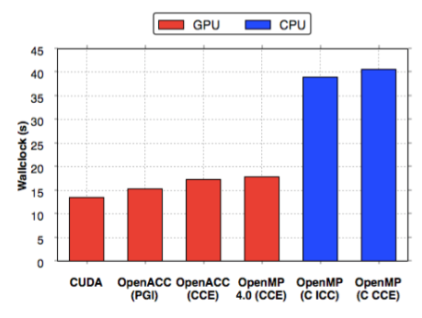
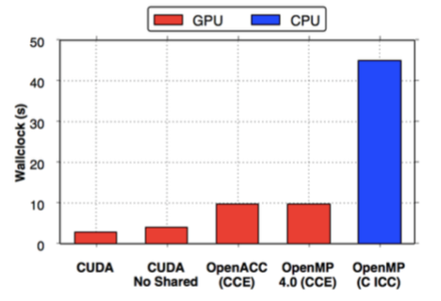
Performance?
* CCE 8.4.3, ICC 15.0.3, PGI 15.01, CUDA 7.0 on an NVIDIA® K20X, and Intel® Xeon® Haswell 16 Core Processor (E5-2698 v3 @ 2.30GHz)
CloverLeaf
Immediately we see impressive performance compared to CUDA
Clearly the Cray compiler leverages the existing OpenACC backend
BUDE
Even with OpenMP 4.5 there is still no way of targeting shared memory directly.
This is set to come in with OpenMP 5.0, and Clang supports targeting address spaces directly
Martineau, M., McIntosh-Smith, S. Gaudin, W., Evaluating OpenMP 4.0’s Effectiveness as a Heterogeneous Parallel Programming Model, 2016, HIPS’16
Third party names are the property of their owners.

Slide 88
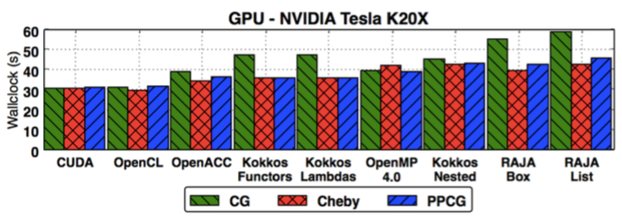
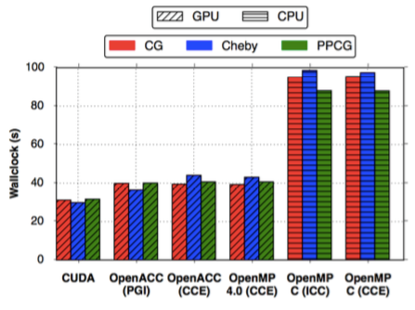
Performance?
* CCE 8.4.3, ICC 15.0.3, PGI 15.01, CUDA 7.0 on an NVIDIA® K20X, and Intel® Xeon® Haswell 16 Core Processor (E5-2698 v3 @ 2.30GHz)
TeaLeaf
We found that Cray’s OpenMP 4.0 implementation achieved great performance on a K20x
It’s likely that these figures have improved even more with maturity of the portable models
Martineau, M., McIntosh-Smith, S. Gaudin, W., Assessing the Performance Portability of Modern Parallel Programming Models using TeaLeaf, 2016, CC-PE
Third party names are the property of their owners.

Slide 89
How do you get good performance?
Our finding so far: You can achieve good performance with OpenMP 4.x.
We achieved this by:
Keeping data resident on the device for the greatest possible time.
Collapsing loops with the collapse clause, so there was a large enough iteration space to saturate the device.
Using the simd directive to vectorize inner loops.
Using schedule(static, 1) for coalescence (obsolete).
Using nvprof of course.

Slide 90
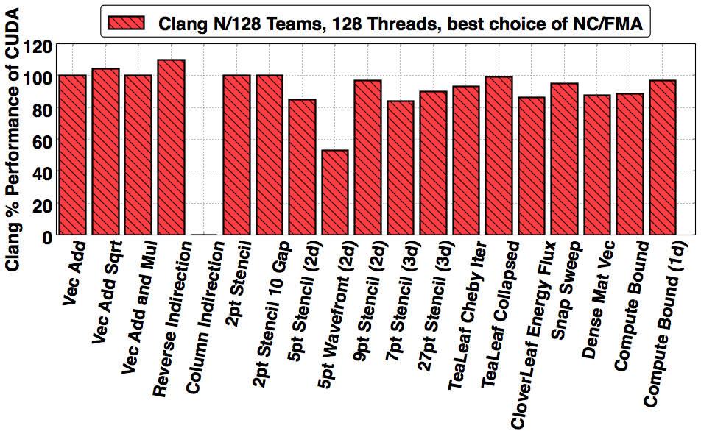
Can you do better?
* Clang copy https://github.com/clang-ykt, CUDA 8.0, NVIDIA K40m
Through extensive tuning of the compiler implementation we were able to execute CloverLeaf mini-app within 9% absolute runtime of hand optimized CUDA code…
Martineau, M., Bertolli, C., McIntosh-Smith, S., et al. Broad Spectrum Performance Analysis of OpenMP 4.5 on GPUs, 2016, PMBS’16
Third party names are the property of their owners.
90￼

Slide 91
Good. Performance… and Portability?
Up until this point we had implicitly proven a good level of portability as we had successfully run OpenMP 4.x on many devices (Intel® CPU, Intel Xeon® Phi™ processors, NVIDIA® GPUs).
The compiler support continually changes, improving performance, correctness and introducing new architecture.
We keep tracking this improvement over time.
Third party names are the property of their owners.
91￼

Slide 92
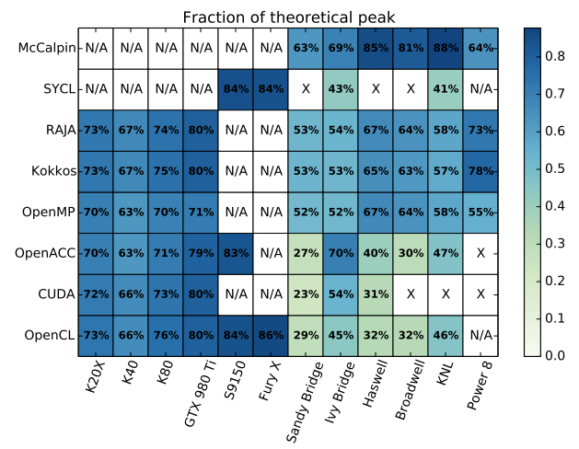
OpenMP in The Matrix.
System Details on the following slide
On those supported target architectures, OpenMP achieves good performance
Deakin, T., Price, J., Martineau, M., McIntosh-Smith, S., GPU-STREAM v2.0 Benchmarking the achievable memory bandwidth of many-core processors across diverse parallel programming models, ISC’16
Third party names are the property of their owners.

Slide 93
System details
Abbreviation | System details
K20X | Cray® XC40, NVIDIA® K20X GPU, Cray compilers version 8.5, gnu 5.3, CUDA 7.5
K40 | Cray® CS cluster, NVIDIA® K40 GPU, Cray compilers version 8.4, gnu 4.9, CUDA 7.5
K80 | Cray® CS cluster, NVIDIA® K40 GPU, Cray compilers version 8.4, gnu 4.9, CUDA 7.5
S9150 | AMD® S9150 GPU. Codeplay® copmputeCpp compiler 2016.05 pre-release. AMD-APP OpenCL 1.2 (1912.5)drivers for SyCL. PGI® Accelerator)TM) 16.4 OpenACC
GTX 980 Ti | NVIDA® GTX 980 Ti. Clang-ykt fork of Clang for OpenMP. PGI® Accelerator™ 16.4 OpenACC. CUDA 7.5
Fury X | AMD® Fury X GPU (based on the Fiji architecture).
Sandy Bridge | Intel® Xeon® E5-2670 CPU. Intel® compilers release 16.0. PGI® Accelerator)TM) 16.4 OpenACC and CUDA-x86. Intel® OpenCL runtime 15.1. Codeplay® copmputeCpp compiler 2016.05 pre-release
Ivy Bridge | Intel® Xeon® E5-2697 CPU. Gnu 4.8 for RAJA and Kokkos, Intel® compiler version 16.0 for stream, Intel® OpenCL runtime 15.1. Codeplay® copmputeCpp compiler 2016.05 pre-release.
Haswell | Cray® XC40, Intel® Xeon® E5-2698 CPU. Intel® compilers release 16.0. PGI® Accelerator)TM) 16.3 OpenACC and CUDA-x86. Gnu 4.8 for RAJA and Kokkos
Broadwell | Cray® XC40, Intel® Xeon® E5-2699 CPU. Intel® compilers release 16.0. PGI® Accelerator)TM) 16.3 OpenACC and CUDA-x86. Gnu 4.8 for RAJA and Kokkos
KNL | Intel® Xeon® Phi™7210 (knights landing) Intel® compilers release 16.0. PGI® Accelerator)TM) 16.4 OpenACC with target specified as AVX2.
Power 8 | IBM® Power 8 processor with the XL 13.1 compiler.
Deakin, T., Price, J., Martineau, M., McIntosh-Smith, S., GPU-STREAM v2.0 Benchmarking the achievable memory bandwidth of many-core processors across diverse parallel programming models, ISC’16

Slide 94
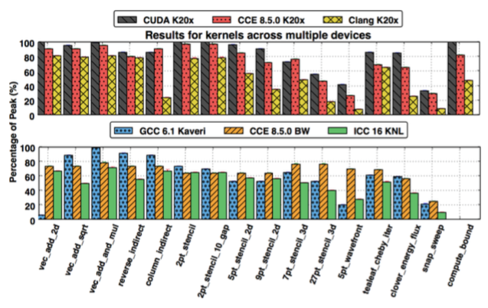
Nice - but beware of the caveat.
There is a MAJOR caveat - the directives were not identical.
Martineau, M., McIntosh-Smith, S. Gaudin, W., Pragmatic Performance Portability with OpenMP 4.x, 2016, IWOMP’16
Third party names are the property of their owners.

Slide 95
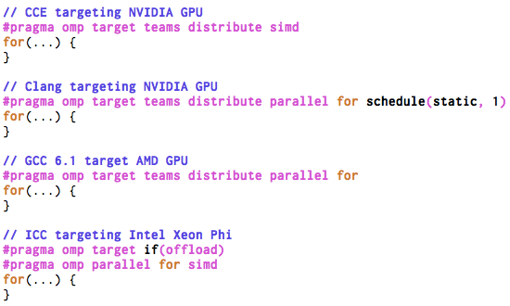
The worst case scenarios.
Four different ways of writing for the same kernel…

Slide 96
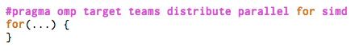
The answer:
If you can - just use the combined construct!
The compilers would accept the combined construct #pragma omp target teams distribute parallel for
This does not generalize to all algorithms unfortunately, but the majority can be adapted.
The construct makes a lot of guarantees to the compiler and it is very easy to reason about for good performance.

Slide 97
Caveats
If you can - just use the combined construct!
Real applications will have algorithms that are structured such that they can’t immediately use the combined construct.
The handling of clauses, such as collapse, can be tricky from a performance portability perspective.
Don’t be misguided… performance is possible without using the combined construct, but it likely won’t be consistent across architecture.

Slide 98
Performance
Portability
If you can - just use the combined construct!
Feature complete implementations will allow you to write performant code, and they will allow you to write portable code.
To get both will likely require algorithmic changes, and a careful approach to using OpenMP 4.5 in your application.
Avoid setting num_teams(nt) and thread_limit(tl) if you can, this is definitely not going to be performance portable.
Use collapse(n) in all situations where you expect the trip count of the outer loop to be short, but be aware that it can have a negative effect on CPU performance.
Use the combined construct whenever you can.

Slide 99

Please tell our SC tutorial overlords how amazingly GREAT this tutorial is!!!!
Online feedback forms available through the following URL or QR code
Evaluation site URL: http://bit.ly/sc17-eval

Slide 100
Conclusion
You can program your GPU with OpenMP
There is no reason to use proprietary “standards”.
Implementations of OpenMP supporting target devices are evolving rapidly … expect to see great improvements in quality and diversity.

